Slide 1
SAPTHAGIRI COLLEGE OF ENGINEERING
(Affiliated to Visvesvaraya Technological University, Belagavi & Approved by AICTE, New Delhi.)
Department of Information Science & Engineering
Mobile Application Development Lab
18CSMP68
BY
Prof. SUDARSANAN D
Assistant Prof, Dept of ISE

Slide 2
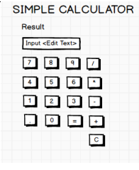
Program-2
Develop an Android application using controls like Button, TextView, EditText for designing a calculator having basic functionality like Addition, Subtraction, Multiplication, and Division.

Slide 3
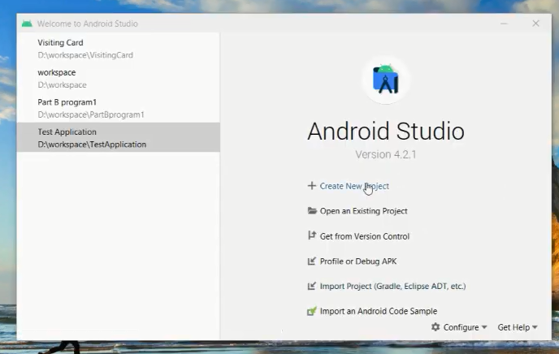
Create a New Project
click

Slide 4
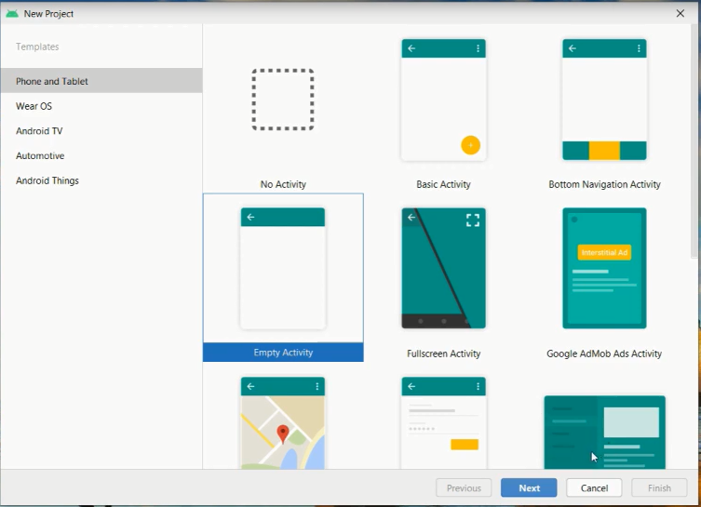
SELECT EMPTY ACTIVITY
CLICK
CLICK NEXT

Slide 5
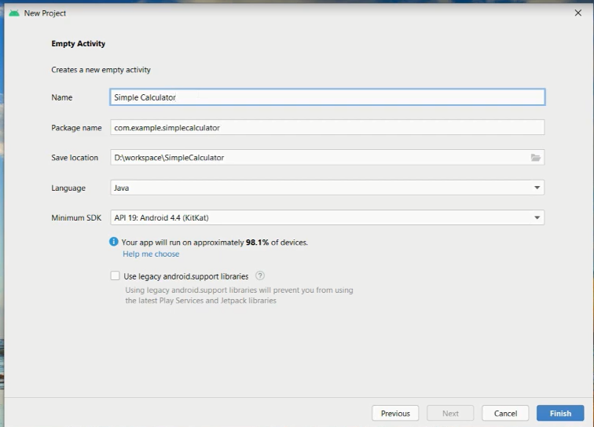
CHANGE EMPTY ACTIVITY NAME TO Simple Calculator
Change name to Simple Calculator
Click finished

Slide 6
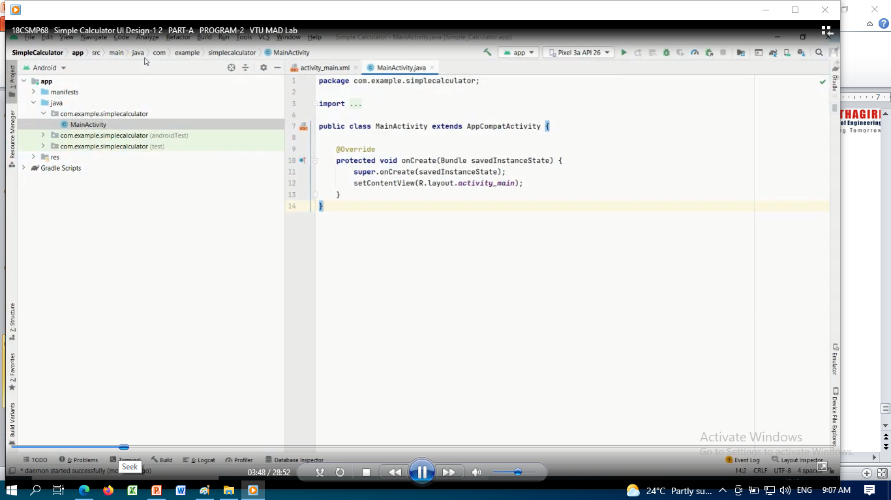
Android Workspace Ready now

Slide 7
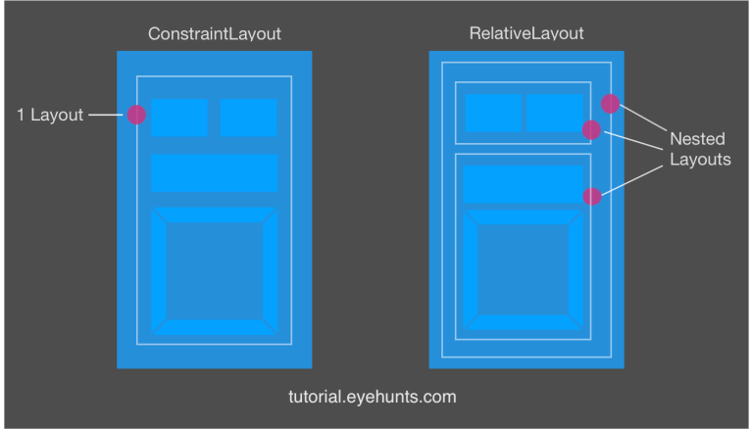
What is the difference between ConstraintLayout and RelativeLayout ?
Constraint Layout has flat view hierarchy unlike other layouts, so does a better performance than relative layout. Yes, this is the biggest advantage of Constraint Layout, the only single layout can handle your UI. Where in the Relative layout you needed multiple nested layouts (LinearLayout + RelativeLayout)

Slide 8
DESIGNING OPERATION OF Simple Calculator
[ALL THE COMPONENT ARE FIXED INSIDE CONSTRAINT LAYOUT]
STEP 1:[First step to select TextView to write a title of Simple Calculator]
GO TO PALETTE→SELECT COMMON→SELECT TextView drag and drop
3
1
2
SIMPLE CALCULATOR
Change the property of attributes:
Text=SIMPLE CALCULATOR
TextColor= Green
TextSize=24sp
Constaint Layout
Result
4
Change the property of attributes:
Text=Result
TextColor= Green
TextSize=24sp
5
Apply constaint to fix the position of simple calculator text vies

Slide 9
Step 2[Add EditText]
GOTO PALETTE→Text→PlainText drag and drop
1
Goto Declaration Attribute change all properties of plaintext boc
Id=Edit_txt
Text=blank
textAlignment=
Textcolor=
textSize=24sp
SIMPLE CALCULATOR
2
Result
3
Apply Constraint for all side to fix the position

Slide 10
Step 3:[Add all NUMBER BUTTONS]
GOTO PALLETE→Button→select Button drag and drop
1
GOTO Declaration Attribute
Id=btn_1
Text=1
Textcolor=
Textsize=
.
.
.
SIMPLE CALCULATOR
Note:
Id=btn_dot
Id=btn_equals
Id-=btn_plus
Id-=btn_minus
Id-=btn_mul
Id-=btn_div
Id-=btn_clear
Result
1
2
3
4
GOTO Declaration Attribute
Id=btn_2
Text=2
Textcolor=
Textsize=
.
.
.
5
6
7
8
9
0
.
=
Apply constraint to all the button to fix the position
+
-
*
/
Note: first do it first button for constraint and then ctr-c and ctr-v to create remaining buttons it will effects constraint
c

Slide 11
Step 4:[MainActivity.java: Add the Listener for these buttons
Create Java variable Buttons to hold button clicked values
Xml file
1
2
2
Btnone=(Button) findViewById(R.id.btn_1);
Btnone.setOnClickListener(this);
.
.
.
.
.
.
txtResult = (EditText) findViewById(R.id.edit_txt); txtResult.setText("");
R CLASS
btn_1 ,btn_2,btn_3,btn_4,btn_5,btn_6,btn_7,btn_8,btn_9,btn_0……..

Slide 12
Create java variable inside MainActivity class
package com.example.simplecalculator; import androidx.appcompat.app.AppCompatActivity; import android.os.Bundle; import android.view.View; import android.widget.Button; import android.widget.EditText; import android.widget.Toast; import java.util.regex.Pattern; public class MainActivity extends AppCompatActivity implements View.OnClickListener
{ Button btnone,btntwo,btnthree,btnfour,btnfive,btnsix,btnseven,btneight,btnnine,btnzero; Button btnAdd,btnSub,btnMul,btnDiv; Button btnclear,btnequal,btndot; EditText txtResult;

Slide 13
Step 5: Now to create Listener using onCreate() Method to listen each button click and pass the data using this pointer
@Override protected void onCreate(Bundle savedInstanceState) { super.onCreate(savedInstanceState); setContentView(R.layout.activity_main); btnone =(Button) findViewById(R.id.btn_1); btnone.setOnClickListener(this); btntwo =(Button) findViewById(R.id.btn_2); btntwo.setOnClickListener(this); btnthree =(Button) findViewById(R.id.btn_3); btnthree.setOnClickListener(this); btnfour =(Button) findViewById(R.id.btn_4); btnfour.setOnClickListener(this); btnfive =(Button) findViewById(R.id.btn_5); btnfive.setOnClickListener(this);
1
Right click the mouse button
Cast parameter to ‘android view.viewOnclick
Make MainActivity implement android view veiw onclickListerner
2
Onclick(v:view):void
3

Slide 14
btnsix =(Button) findViewById(R.id.btn_6); btnsix.setOnClickListener(this); btnseven =(Button) findViewById(R.id.btn_7); btnseven.setOnClickListener(this); btneight =(Button) findViewById(R.id.btn_8); btneight.setOnClickListener(this); btnnine =(Button) findViewById(R.id.btn_9); btnnine.setOnClickListener(this); btnzero =(Button) findViewById(R.id.btn_0); btnzero.setOnClickListener(this);
btnAdd =(Button) findViewById(R.id.btn_plus); btnAdd.setOnClickListener(this); btnSub =(Button) findViewById(R.id.btn_minus); btnSub.setOnClickListener(this); btnMul =(Button) findViewById(R.id.btn_mul); btnMul.setOnClickListener(this);
btnDiv =(Button) findViewById(R.id.btn_div); btnDiv.setOnClickListener(this); btndot =(Button) findViewById(R.id.btn_dot); btndot.setOnClickListener(this); btnclear =(Button) findViewById(R.id.btn_clear); btnclear.setOnClickListener(this); btnequal =(Button) findViewById(R.id.btn_equals); btnequal.setOnClickListener(this); txtResult = (EditText) findViewById(R.id.edit_txt); txtResult.setText(""); }

Slide 15
Step 6: Define the Action for individual button to perform certain Action
3
@Override public void onClick(View view) { if(view.equals(btnone)) txtResult.append("1"); if(view.equals(btntwo)) txtResult.append("2"); if(view.equals(btnthree)) txtResult.append("3"); if(view.equals(btnfour)) txtResult.append("4"); if(view.equals(btnfive)) txtResult.append("5"); if(view.equals(btnsix)) txtResult.append("6"); if(view.equals(btnseven)) txtResult.append("7");
if(view.equals(btneight)) txtResult.append("8"); if(view.equals(btnnine)) txtResult.append("9");
if(view.equals(btnzero)) txtResult.append("0"); if(view.equals(btndot)) txtResult.append("."); if(view.equals(btnAdd)) txtResult.append("+"); if(view.equals(btnSub)) txtResult.append("-"); if(view.equals(btnMul)) txtResult.append("*"); if(view.equals(btnDiv)) txtResult.append("/");

Slide 16
if(view.equals(btnclear)) txtResult.setText("");
if(view.equals(btnequal))
try { String data = txtResult.getText().toString(); if(data.contains("/")) { divide(data); //user define function } else if(data.contains("*")) { multiplication(data); }
else if(data.contains("+")) { addition(data); }
else if(data.contains("-")) { subtration(data); } }
catch (Exception e) { displayInvalidMessage("Invalid Operation"); } }
Right click mouse button or
Show control action
Create Method divide in MainAction
click
Private void divide(String data)
{
}

Slide 17
private void displayInvalidMessage(String mes)
{ Toast.makeText(getBaseContext(), mes, Toast.LENGTH_LONG).show(); } private void subtration(String data)
{ String[] operands = data.split("-"); if (operands.length == 2)
{ Double operand1 = Double.parseDouble(operands[0]); Double operand2 = Double.parseDouble(operands[1]); Double result = operand1 - operand2; txtResult.setText(String.valueOf(result)); } else { displayInvalidMessage("invalid input"); } }

Slide 18
private void addition(String data)
{ String[] operands = data.split(Pattern.quote("+")); if (operands.length == 2)
{ Double operand1 = Double.parseDouble(operands[0]); Double operand2 = Double.parseDouble(operands[1]); Double result = operand1 + operand2; txtResult.setText(String.valueOf(result)); } else { displayInvalidMessage("invalid input"); } }

Slide 19
private void divide(String data)
{ String[] operands = data.split("/"); if (operands.length == 2)
{ Double operand1 = Double.parseDouble(operands[0]); Double operand2 = Double.parseDouble(operands[1]); Double result = operand1 / operand2; txtResult.setText(String.valueOf(result)); }
else { displayInvalidMessage("invalid input"); } }

Slide 20
private void multiplication(String data)
{ String[] operands = data.split(Pattern.quote("*")); if (operands.length == 2)
{ Double operand1 = Double.parseDouble(operands[0]); Double operand2 = Double.parseDouble(operands[1]); Double result = operand1 * operand2; txtResult.setText(String.valueOf(result)); }
else { displayInvalidMessage("invalid input"); } } }

Slide 21
output

